Slide 1



Noida Institute of Engineering and Technology, Greater Noida
Creational Design Pattern
Unit: II
Design Pattern(ACSE0514)
Shweta Singh
Assistant Professor
CSE(AI)
Course Details (B Tech 5th Sem)

Slide 2
Faculty Introduction
Name | Shweta Singh
Qualification | M. Tech. (CSE),Pursuing Ph.d(Engineering)
Designation | Assistant Professor
Department | Computer Science & Engineering-AI
Total Experience | 13 years
NIET Experience | 1 years
Subject Taught | Core Java and Advance Java , BDA using Excel, Artificial Intelligence, Soft Computing, C Programming, Web Technology, Discrete Mathematics,Operating System,OOPs ,C++,Computer Graphics.

Slide 3
Evaluation Scheme
Python Web development with Django (Elective I)
Design Pattern (Elective II)

Slide 4
Syllabus
UNIT-I: Introduction of Design Pattern
Describing Design Patterns, Design Patterns in Smalltalk MVC, The Catalogue of Design Patterns, Organizing The Catologue, How Design Patterns solve, Design Problems, How to Select a Design pattern, How to Use a Design Pattern. Principle of least knowledge.

Slide 5
Syllabus
UNIT-II: Creational Design Pattern
Creational Patterns: Abstract Factory, Builder , Factory Pattern, Prototype Pattern , Singleton Pattern.

Slide 6
Syllabus
UNIT-III: Structural Design Pattern
Structural Pattern Part-I, Adapter, Bridge, Composite.
Structural Pattern Part-II, Decorator, Facade, Flyweight, Proxy.

Slide 7
Syllabus
UNIT-IV: Behavioral Design Patterns Part: I
Behavioral Patterns Part: I, Chain of Responsibility, Command, Interpreter, Iterator Pattern.
Behavioral Patterns Part: II, Mediator, Memento, Observer, Patterns.

Slide 8
Syllabus
UNIT-V: Behavioral Design Patterns Part: II
Behavioral Patterns Part: III, State, Strategy, Template Method, Visitor, What to Expect from Design Patterns. A case Study: Designing a document Editor.

Slide 9
Branch Wise Application
1. Real-time web analytics
2. Digital Advertising
3. E-Commerce
4. Publishing
5. Massively Multiplayer Online Games
6. Backend Services and Messaging
7. Project Management & Collaboration
8. Real time Monitoring Services
9.Live Charting and Graphing
10. Group and Private Chat

Slide 10
Course Objective
In this semester, the students will
Study how to show relationships and interactions between classes or objects.
Study to speed up the development process by providing well-tested, proven development/design paradigms.
Select a specific design pattern for the solution of a given design problem.
Create a catalog entry for a simple design pattern whose purpose and application are understood.

Slide 11
Course Outcomes (COs)
At the end of course, the student will be able to:
CO1 : Construct a design consisting of collection of modules.
CO2 : Exploit well known design pattern such as Factory, visitor etc.
CO3 : Distinguish between different categories of design patterns.
CO4 : Ability to common design pattern for incremental development.
CO5 : Identify appropriate design pattern for a given problem and design the software using pattern oriented architecture.

Slide 12
Program Outcomes (POs)
Engineering Graduates will be able to:
PO1 : Engineering Knowledge
PO2 : Problem Analysis
PO3 : Design/Development of solutions
PO4 : Conduct Investigations of complex problems
PO5 : Modern tool usage
PO6 : The engineer and society

Slide 13
Program Outcomes (POs)
Engineering Graduates will be able to:
PO7 : Environment and sustainability
PO8 : Ethics
PO9 : Individual and teamwork
PO10 : Communication
PO11 : Project management and finance
PO12 : Life-long learning

Slide 14
COs - POs Mapping
CO.K | PO1 | PO2 | PO3 | PO4 | PO5 | PO6 | PO7 | PO8 | PO9 | PO10 | PO11 | PO12
CO1 | 2 | 2 | 2 | 3 | 3 | - | - | - | - | - | - | -
CO2 | 3 | 2 | 3 | 2 | 3 | - | - | - | - | - | - | -
CO3 | 3 | 2 | 3 | 2 | 3 | - | - | - | - | - | - | -
CO4 | 3 | 2 | 3 | 2 | 3 | - | - | - | - | - | - | -
CO5 | 3 | 2 | 3 | 3 | 3 | - | - | - | - | - | - | -
AVG | 2.8 | 2.0 | 2.8 | 2.4 | 3.0 | - | - | - | - | - | - | -

Slide 15
Program Specific Outcomes(PSOs)
S. No. | Program Specific Outcomes (PSO) | PSO Description
1 | PSO1 | Understand to shows relationships and interactions between classes or objects of a pattern.
2 | PSO2 | Study to speed up the development process by providing well-tested, proven development
3 | PSO3 | Select a specific design pattern for the solution of a given design problem
4 | PSO4 | Create a catalogue entry for a simple design pattern whose purpose and application is understood.

Slide 16
COs - PSOs Mapping
CO.K | PSO1 | PSO2 | PSO3 | PSO4
CO1 | 3 | - | - | -
CO2 | 3 | 3 | - | -
CO3 | 3 | 3 | - | -
CO4 | 3 | 3 | - | -
CO5 | 3 | 3 | - | -

Slide 17
Program Educational Objectives (PEOs)
Program Educational Objectives (PEOs) | PEOs Description
PEOs | To have an excellent scientific and engineering breadth so as to comprehend, analyze, design and provide sustainable solutions for real-life problems using state-of-the-art technologies.
PEOs | To have a successful career in industries, to pursue higher studies or to support entrepreneurial endeavors and to face the global challenges.
PEOs | To have an effective communication skills, professional attitude, ethical values and a desire to learn specific knowledge in emerging trends, technologies for research, innovation and product development and contribution to society.
PEOs | To have life-long learning for up-skilling and re-skilling for successful professional career as engineer, scientist, entrepreneur and bureaucrat for betterment of society.

Slide 18
Result Analysis(Department Result & Subject Result & Individual result
Name of the faculty | Subject code | Result % of clear passed
Mr. Sanjay Nayak

Slide 19
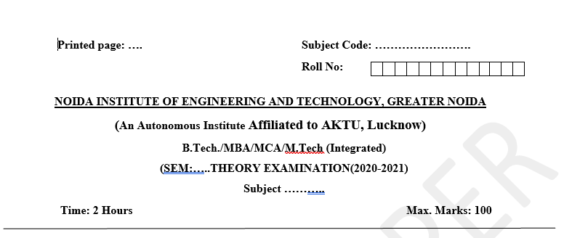
Pattern of Online External Exam Question Paper (100 marks)

Slide 20
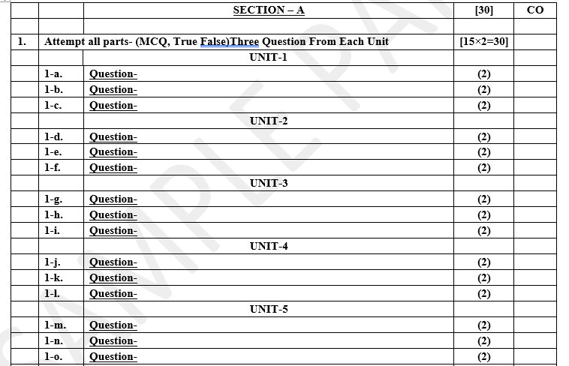
Pattern of Online External Exam Question Paper (100 marks)

Slide 21
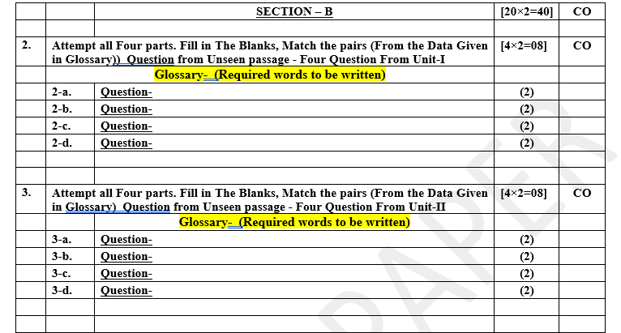
Pattern of Online External Exam Question Paper (100 marks)

Slide 22

Pattern of Online External Exam Question Paper (100 marks)

Slide 23

Pattern of Online External Exam Question Paper (100 marks)

Slide 24
Prerequisite / Recap
Students should know object-oriented analysis and design.
Knowledge of Data structure and algorithm.
knowledge of Programming languages such as C/C++ etc.
Good problem-solving Skills.

Slide 25
Brief Introduction about the Subject with video
YouTube /other Video Links
https://youtu.be/rI4kdGLaUiQ?list=PL6n9fhu94yhUbctIoxoVTrklN3LMwTCmd
https://youtu.be/v9ejT8FO-7I?list=PLrhzvIcii6GNjpARdnO4ueTUAVR9eMBpc
https://youtu.be/VGLjQuEQgkI?list=PLt4nG7RVVk1h9lxOYSOGI9pcP3I5oblbx

Slide 26
Unit II Content
Creational Patterns:
Abstract Factory.
Builder Factory Method.
Factory Pattern.
Prototype Patterns.
Singleton Patterns.

Slide 27
Unit II Objective
In Unit II, the students will be able to find
What are Creational Patterns and their types in detail.
Learn the concept of Abstract Factory.
How Builder Factory Method works.
How and when we use Prototype Patterns.
Simplest and easiest pattern is Singleton Patterns how .

Slide 28
Topic Objective
Topic : Creational Patterns (Abstract Factory)
In this topic, the students will learn what are Creational Patterns that help in real world problems what are abstract factory methods and how Creates an instance of several families of classes.

Slide 29
Creational Patterns
Creational patterns:-
In software engineering, creational design patterns are design patterns that deal with object creation mechanisms, trying to create objects in a manner suitable to the situation. The basic form of object creation could result in design problems or added complexity to the design. Creational design patterns solve this problem by somehow controlling this object creation.
creational pattern provides one of the best ways to create an object.
Creational design patterns are concerned with the way of creating objects. These design patterns are used when a decision must be made at the time of instantiation of a class (i.e. creating an object of a class).

Slide 30
Abstract Factory Pattern
Abstract Factory patterns:-
Abstract Factory Pattern says that just defines an interface or abstract class for creating families of related (or dependent) objects but without specifying their concrete sub-classes. That means Abstract Factory lets a class return a factory of classes. So, this is the reason that the Abstract Factory Pattern is one level higher than the Factory Pattern.
An Abstract Factory Pattern is also known as a Kit.

Slide 31
Abstract Factory Pattern
Advantage of Abstract Factory Pattern:-
Abstract Factory Pattern isolates the client code from concrete (implementation) classes.
It eases the exchanging of object families.
It promotes consistency among objects.
Usage of Abstract Factory Pattern:-
When the system needs to be independent of how its object are created, composed, and represented.
When the family of related objects has to be used together, then this constraint needs to be enforced.
When you want to provide a library of objects that does not show implementations and only reveals interfaces.

Slide 32
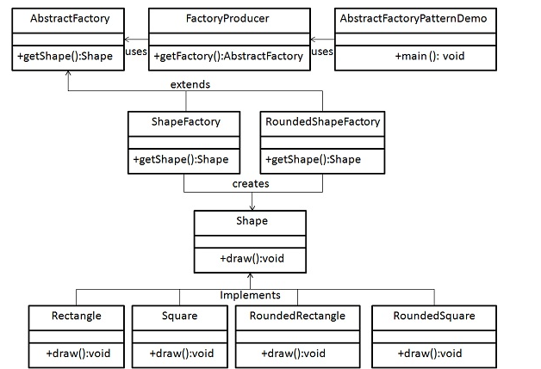
UML\Structure for Abstract Factory Pattern

Slide 33
Implementation
We are going to create a Shape interface and a concrete class implementing it. We create an abstract factory class AbstractFactory as next step. Factory class ShapeFactory is defined, which extends AbstractFactory. A factory creator/generator class FactoryProducer is created.
AbstractFactoryPatternDemo, our demo class uses FactoryProducer to get a AbstractFactory object. It will pass information (CIRCLE / RECTANGLE / SQUARE for Shape) to AbstractFactory to get the type of object it needs.

Slide 34
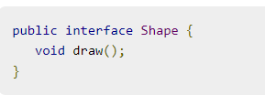
Implementation of Abstract Factory Pattern
Step 1
Create an interface for Shapes.
(Shape.java)

Slide 35
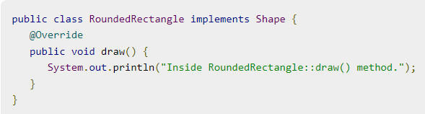
Implementation of Abstract Factory Pattern
Step 2
Create concrete classes implementing the same interface.
(RoundedRectangle.java)

Slide 36

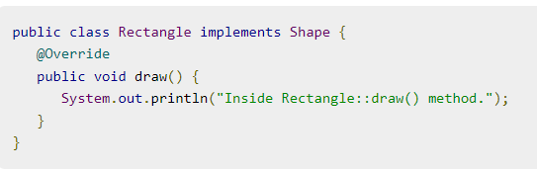
Implementation of Abstract Factory Pattern
Step 2 CONT…….
(RoundedSquare.java)
(Rectangle.java)

Slide 37
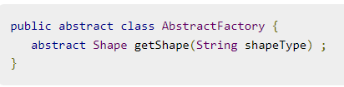
Implementation of Abstract Factory Pattern
Step 3
Create an Abstract class to get factories for Normal and Rounded Shape Objects.
AbstractFactory.java

Slide 38
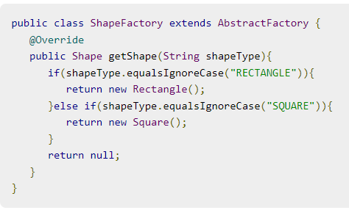
Implementation of Abstract Factory Pattern
Step 4
Create Factory classes extending AbstractFactory to generate object of concrete class based on given information.
(ShapeFactory.java)

Slide 39
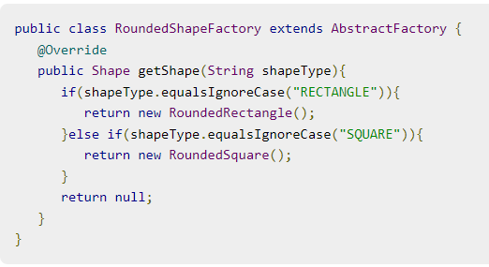
Implementation of Abstract Factory Pattern
Step 4
(RoundedShapeFactory.java)

Slide 40
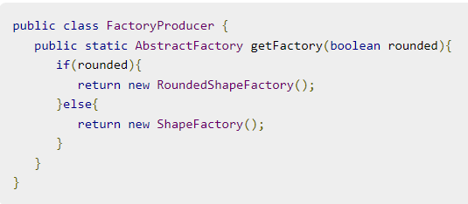
Implementation of Abstract Factory Pattern
Step 5
Create a Factory generator/producer class to get factories by passing an information such as Shape
(FactoryProducer.java)

Slide 41
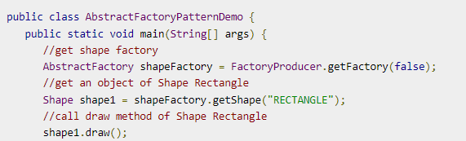
Implementation of Abstract Factory Pattern
Step 6
Use the FactoryProducer to get AbstractFactory in order to get factories of concrete classes by passing an information such as type.
(AbstractFactoryPatternDemo.java)

Slide 42
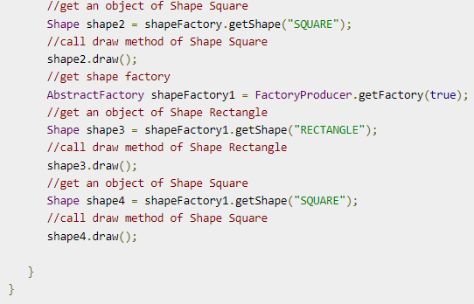
Implementation of Abstract Factory Pattern
Cont……

Slide 43
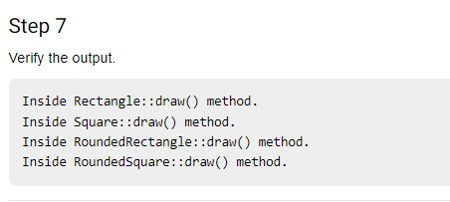
Implementation of Abstract Factory Pattern
Step 7

Slide 44
Topic Objective
Topic: Creational Patterns (Builder Design Pattern)
In this topic, the students will learn what are Creational Patterns help in real-world problems what are Builder Design Patterns, and how to construct a complex object from simple objects using a step-by-step approach.

Slide 45
Builder Design Pattern
Builder Design Pattern:-
Builder Pattern says that "construct a complex object from simple objects using step-by-step approach“.
It is mostly used when object can't be created in single step like in the
de-serialization of a complex object.
Advantage of Builder Design Pattern:-
The main advantages of Builder Pattern are as follows:
It provides clear separation between the construction and representation of an object.
It provides better control over construction process.
It supports to change the internal representation of objects.

Slide 46
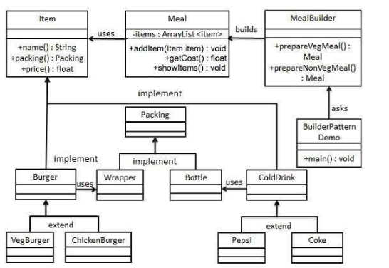
UML\Structure for Builder Design Pattern

Slide 47
Implementation
We have considered a business case of a fast-food restaurant where a typical meal could be a burger and a cold drink. The burger could be either a Veg Burger or Chicken Burger and will be packed in a wrapper. The cold drink could be either a coke or Pepsi and will be packed in a bottle.
We are going to create an Item interface representing food items such as burgers and cold drinks with concrete classes implementing the Item interface and a Packing interface representing the packaging of food items and concrete classes implementing the Packing interface as burgers would be packed in the wrapper and cold drink would be packed as a bottle.
We then create a Meal class having an ArrayList of Item and a MealBuilder to build different types of Meal objects by combining Item. BuilderPatternDemo, our demo class will use MealBuilder to build a Meal.

Slide 48
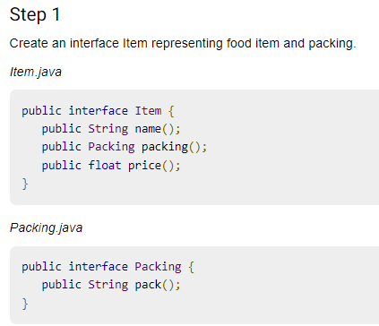
Implementation of Builder Design Pattern

Slide 49
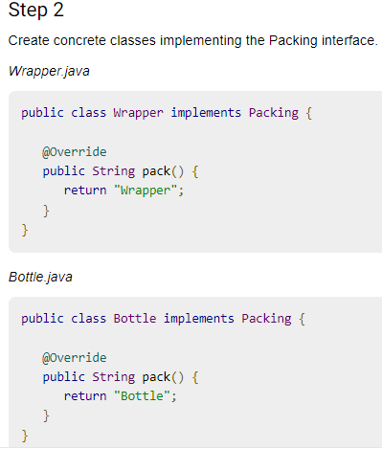
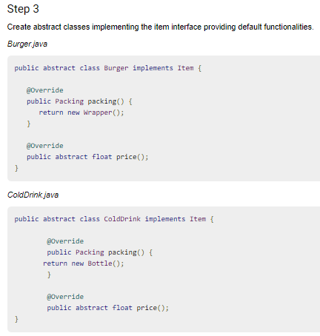
Implementation of Builder Design Pattern

Slide 50
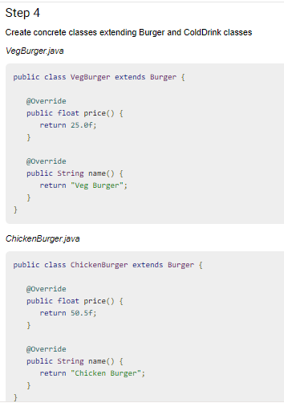
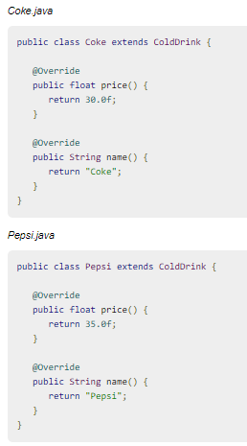
Implementation of Builder Design Pattern

Slide 51
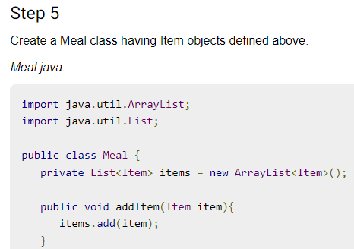
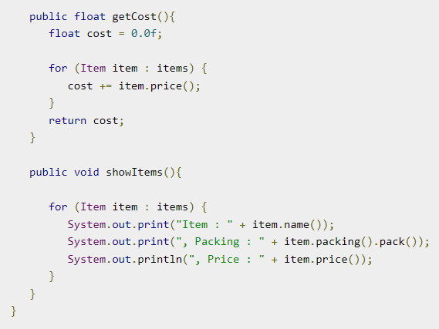
Implementation of Builder Design Pattern

Slide 52
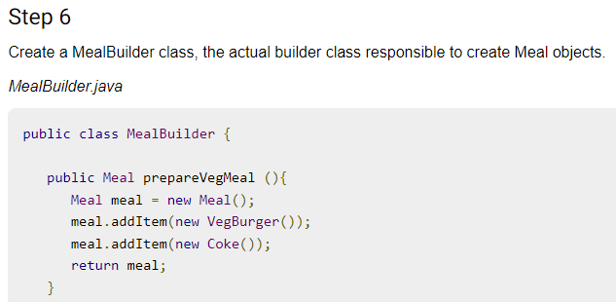
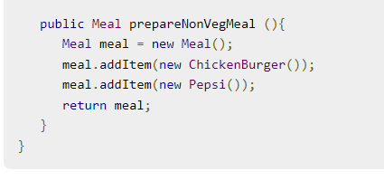
Implementation of Builder Design Pattern

Slide 53

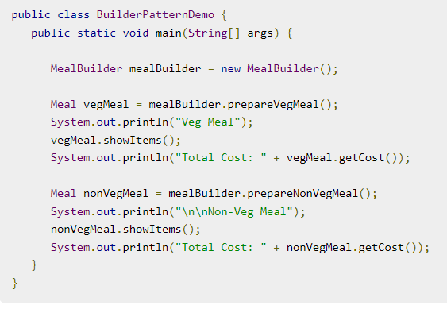
Implementation of Builder Design Pattern

Slide 54
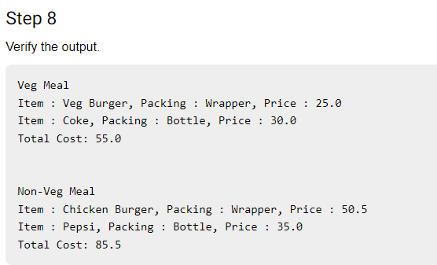
Implementation of Builder Design Pattern

Slide 55
Topic Objective
Topic : Creational Patterns (Factory Design Pattern)
In this topic, the students will learn what are Creational Patterns that help in real world problem and what are Factory Pattern and how to define an interface or abstract class for creating an object but let the subclasses decide which class to instantiate.

Slide 56
Factory Design Pattern
Factory Design Pattern:-
A Factory Pattern or Factory Method Pattern says that just define an interface or abstract class for creating an object but let the subclasses decide which class to instantiate. In other words, subclasses are responsible to create the instance of the class.
The Factory Method Pattern is also known as Virtual Constructor.
Advantage of Factory Design Pattern:-
Factory Method Pattern allows the sub-classes to choose the type of objects to create.
It promotes the loose-coupling by eliminating the need to bind application-specific classes into the code. That means the code interacts solely with the resultant interface or abstract class, so that it will work with any classes that implement that interface or that extends that abstract class.

Slide 57
Factory Design Pattern
Usage of Factory Design Pattern:-
When a class doesn't know what sub-classes will be required to create.
When a class wants its sub-classes to specify the objects to be created.
When the parent classes choose the creation of objects to its sub-classes.
Factory pattern is one of the most used design patterns in Java. This type of design pattern comes under creational pattern as this pattern provides one of the best ways to create an object.
In the Factory pattern, we create an object without exposing the creation logic to the client and refer to the newly created object using a common interface.

Slide 58
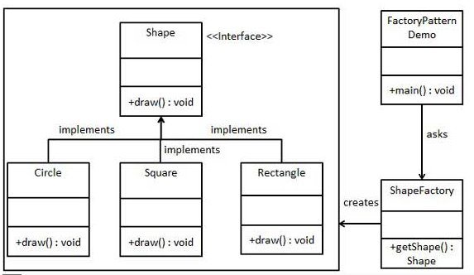
UML\Structure for Factory Design Pattern

Slide 59
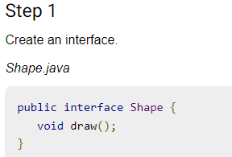
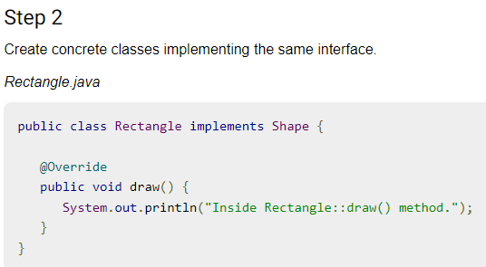
Implementation
We're going to create a Shape interface and concrete classes implementing the Shape interface. A factory class ShapeFactory is defined as a next step.
FactoryPatternDemo, our demo class will use ShapeFactory to get a Shape object. It will pass information (CIRCLE / RECTANGLE / SQUARE) to ShapeFactory to get the type of object it needs.

Slide 60

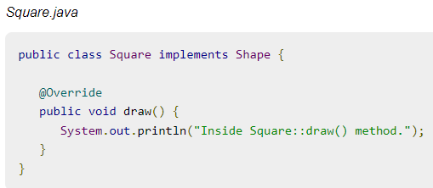
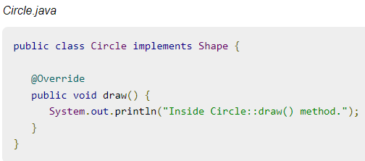
Implementation

Slide 61
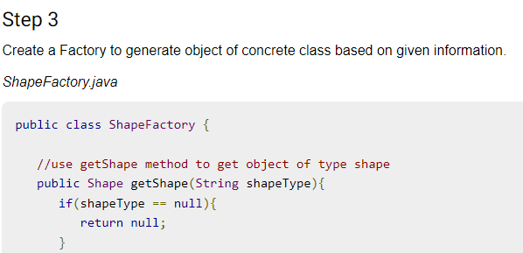
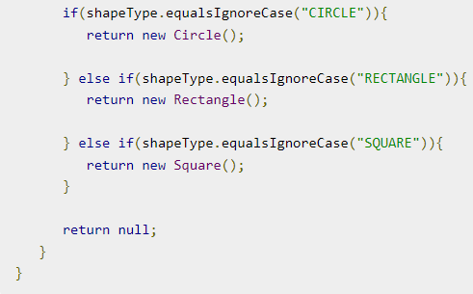
Implementation

Slide 62
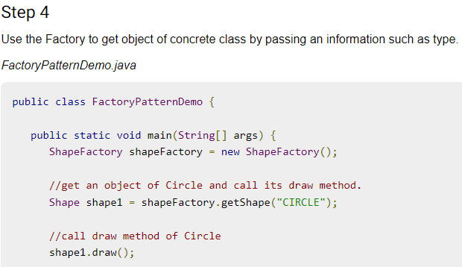
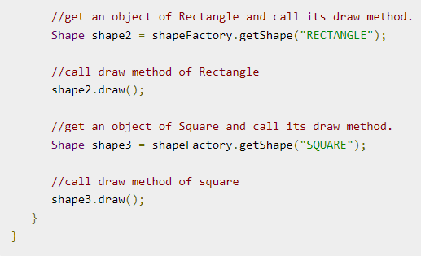
Implementation

Slide 63
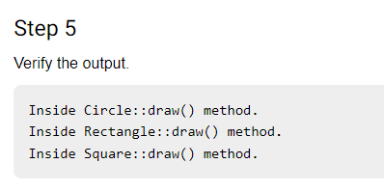
Implementation

Slide 64
Topic Objective
Topic : Creational Patterns (Prototype Design Pattern)
In this topic, the students will learn what are Creational Patterns that help in real-world problems what are Prototype Patterns, and how to clone an existing object instead of creating a new one which can also be customized as per the requirement.

Slide 65
Prototype Design Pattern
Prototype Design Pattern:-
Prototype Pattern says that cloning an existing object instead of creating new one and can also be customized as per the requirement.
This pattern should be followed if the cost of creating a new object is expensive and resource-intensive.
Advantages of Prototype Design Pattern:-
The main advantages of the prototype pattern are as follows:
It reduces the need for sub-classing.
It hides the complexities of creating objects.
The clients can get new objects without knowing which type of object it will be.
It lets you add or remove objects at runtime.

Slide 66
Prototype Design Pattern
Usage of Prototype Design Pattern:-
When the classes are instantiated at runtime.
When the cost of creating an object is expensive or complicated.
When you want to keep the number of classes in an application minimum.
When the client application needs to be unaware of object creation and representation.
This pattern is used when creation of object directly is costly. For example, an object is to be created after a costly database operation. We can cache the object, returns its clone on next request and update the database as and when needed thus reducing database calls.

Slide 67
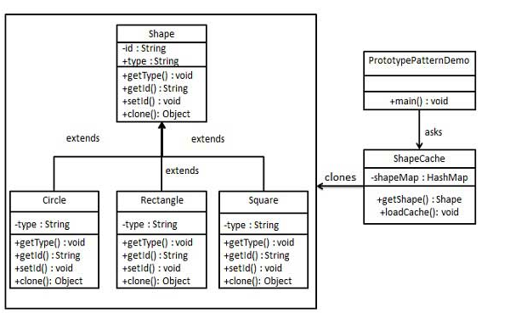
UML\Structure for Prototype Design Pattern

Slide 68
Implementation of Prototype Design Pattern
Prototype pattern refers to creating duplicate object while keeping performance in mind. This type of design pattern comes under creational pattern as this pattern provides one of the best ways to create an object.
This pattern involves implementing a prototype interface which tells to create a clone of the current object.
We're going to create an abstract class Shape and concrete classes extending the Shape class. A class ShapeCache is defined as a next step which stores shape objects in a Hashtable and returns their clone when requested.
PrototypPatternDemo, our demo class will use ShapeCache class to get a Shape object.

Slide 69
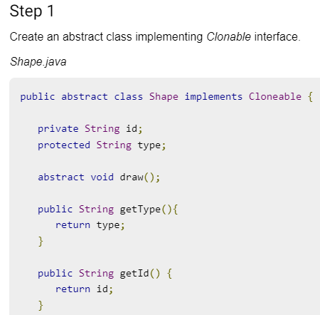
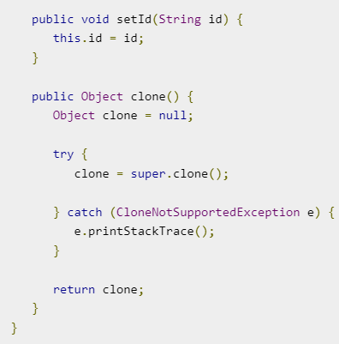
Implementation of Prototype Design Pattern

Slide 70
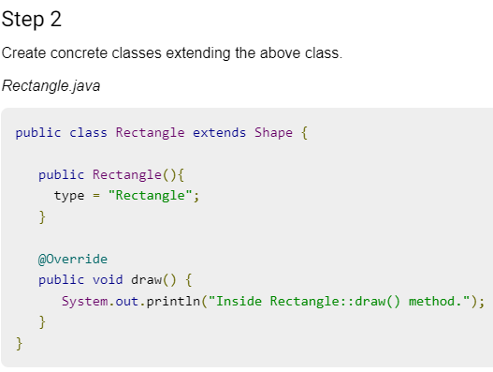
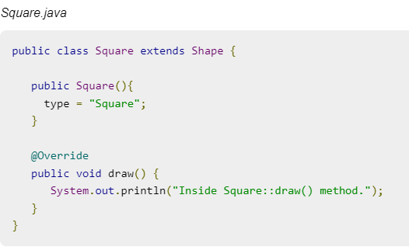
Implementation of Prototype Design Pattern

Slide 71
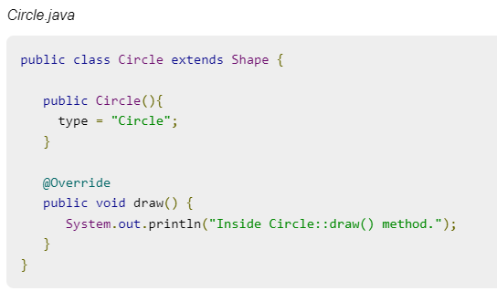
Implementation of Prototype Design Pattern

Slide 72
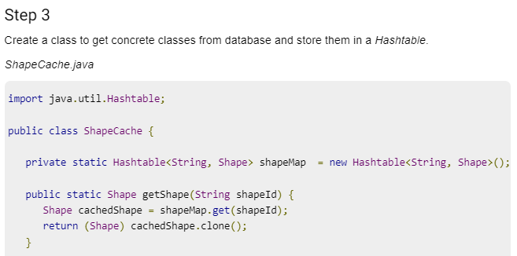
Implementation of Prototype Design Pattern

Slide 73
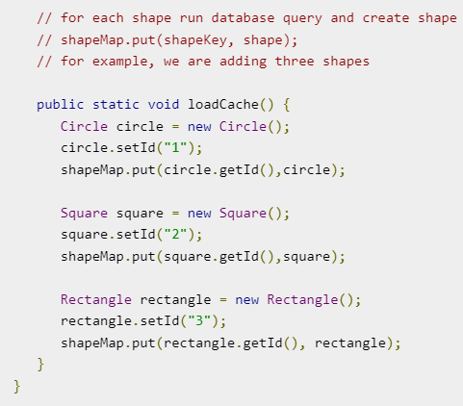
Implementation of Prototype Design Pattern

Slide 74
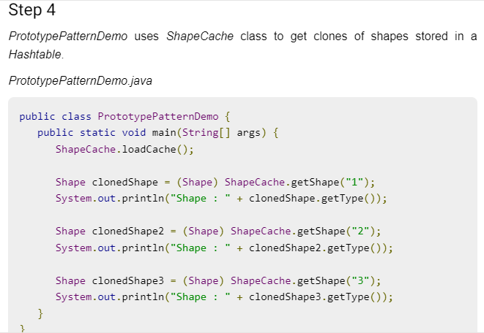
Implementation of Prototype Design Pattern

Slide 75
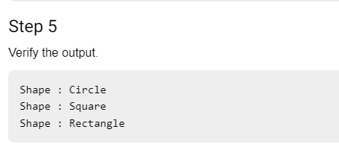
Implementation of Prototype Design Pattern

Slide 76
Topic Objective
Topic: Creational Patterns (Singleton Design Pattern)
In this topic, the students will learn what are Creational Patterns that help in real-world problems and what are Singleton Pattern and how a Singleton Pattern says that just "define a class that has only one instance and provides a global point of access to it".

Slide 77
Singleton Design Patterns
Singleton Design patterns:-
Singleton Pattern says that just“ define a class that has only one instance and provides a global point of access to it".
In other words, a class must ensure that only single instance should be created and single object can be used by all other classes.
There are two forms of singleton design pattern:-
Early Instantiation: creation of instance at load time.
Lazy Instantiation: creation of instance when required.

Slide 78
Singleton Design Patterns
Advantage of Singleton Design Pattern:-
It saves memory because the object is not created at each request. Only a single instance is reused again and again.
Usage of Singleton design pattern :-
Singleton pattern is mostly used in multi-threaded and database applications. It is used in logging, caching, thread pools, configuration settings, etc.

Slide 79
Singleton Design Patterns
How to create Singleton design pattern:-
To create the singleton class, we need to have static member of class, private constructor and static factory method.
Static member: It gets memory only once because of static, it contains the instance of the Singleton class.
Private constructor: It will prevent to instantiate the Singleton class from outside the class.
Static factory method: This provides the global point of access to the Singleton object and returns the instance to the caller.

Slide 80
Implementation
Singleton pattern is one of the simplest design patterns in Java. This type of design pattern comes under creational pattern as this pattern provides one of the best ways to create an object.
We're going to create a SingleObject class. SingleObject class have its constructor as private and have a static instance of itself.
SingleObject class provides a static method to get its static instance to outside world. SingletonPatternDemo, our demo class will use SingleObject class to get a SingleObject object.

Slide 81
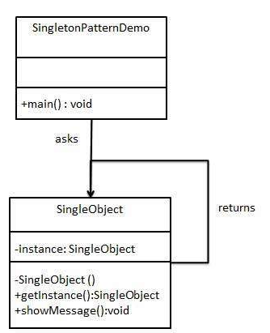
UML\Structure for Singleton Design Pattern-1

Slide 82
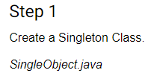
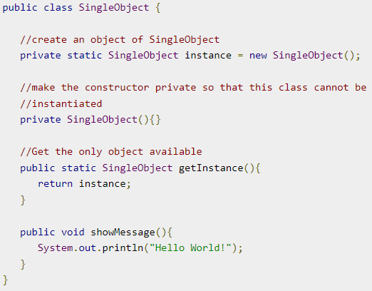
Implementation of Singleton Design Pattern

Slide 83
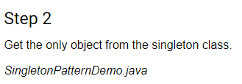


Implementation of Singleton Design Pattern

Slide 84
Example for Singleton Design Pattern
let's say we want to model the American President's official aircraft called "Airforce One" in our software.
There can only be one instance of Airforce One and a singleton class is the best suited representation.

Slide 85
UML/Structure for Singleton Design Pattern- “Airforce One”
Singleton:Airforce One
Client
onlyInstance : Singleton
+getInstance():Singleton

Slide 86
Implementation of “Airforce One”-Singleton Design Pattern
public class AirforceOne {
// The sole instance of the class
private static AirforceOne onlyInstance;
// Make the constructor private so its only accessible to
// members of the class.
private AirforceOne() {
}
public void fly() {
System.out.println("Airforce one is flying...");
}
// Create a static method for object creation
public static AirforceOne getInstance() {
// Only instantiate the object when needed.
if (onlyInstance == null) {
onlyInstance = new AirforceOne();
}
return onlyInstance;
}
}
Step 1
Create a Singleton Class
AirforceOne.java

Slide 87
Implementation of “Airforce One”-Singleton Design Pattern
Step 2
Get the only object from the Singleton Class
Client.java
public class Client {
public void main() {
AirforceOne airforceOne = AirforceOne.getInstance();
airforceOne.fly();
}
}
Step 3
Output
Airforce one is flying...

Slide 88
Daily Quiz
Which of the following pattern refers to creating duplicate object while keeping performance in mind.
Builder Pattern
Bridge Pattern
Prototype Pattern
Filter Pattern.
Define the skeleton of an algorithm in an operation, deferring some steps to subclasses. It lets subclasses redefine certain steps of an algorithm without changing the algorithm structure.
Chain of responsibility
Template method
Interpreter
Prototype

Slide 89
Daily Quiz
Which design pattern suggest multiple classes through which request is passed and multiple but only relevant classes carry out operations on the request.
Singleton pattern
Chain of responsibility pattern
State pattern
Bridge pattern
Most user interface design patterns fall with in one of ____ categories of patterns.
5
10
25
100

Slide 90
Weekly Assignment
What are Design Patterns in Java? What are the types of design patterns in Java.
What are the Creational Patterns and What Is Factory Pattern.
What Is Abstract Factory Pattern.
Explain Structural Patterns in Java.
5. Explain the Singleton pattern.

Slide 91
Topic Link ( YouTube & NPTEL Video Links)
YouTube /other Video Links
https://youtu.be/rI4kdGLaUiQ?list=PL6n9fhu94yhUbctIoxoVTrklN3LMwTCmd
https://youtu.be/v9ejT8FO-7I?list=PLrhzvIcii6GNjpARdnO4ueTUAVR9eMBpc
https://youtu.be/VGLjQuEQgkI?list=PLt4nG7RVVk1h9lxOYSOGI9pcP3I5oblbx

Slide 92
MCQ (End of Unit)
1. Design patterns can be classified in _______ categories.
1
2
3
4
2. Which design patterns are specifically concerned with communication between objects?
Creational Patterns
Structural Patterns
Behavioral Patterns
J2EE Patterns

Slide 93
MCQ (End of Unit)
3. Which design pattern provides a single class which provides simplified methods required by client and delegates call to those methods?
Adapter pattern
Builder pattern
Facade pattern
Prototype pattern
4. Which design pattern suggests multiple classes through which request is passed and multiple but only relevant classes carry out operations on the request?
Singleton pattern
Chain of responsibility pattern
State pattern
Bridge pattern

Slide 94

End Semester Question Paper

Slide 95

End Semester Question Paper

Slide 96
Glossary Questions
Top 10 design pattern interview questions
What are design patterns?
How are design patterns categorized?
Explain the benefits of design patterns in Java.
Describe the factory pattern.
Differentiate ordinary and abstract factory design patterns.
What do you think are the advantages of builder design patterns?
How is the bridge pattern different from the adapter pattern?
What is a command pattern?
Describe the singleton pattern along with its advantages and disadvantages.
What are anti patterns?

Slide 97
Expected Questions for the University Exam
Explain details about the prototype design pattern.
Explain abstract factory design patterns.
List and explain the implementation issues of the factory method.
Give a brief description of the singleton creational pattern.
Explain the role of creational patterns in the design of a pattern.
Describe details about the prototype design patterns.
Explain creational patterns for the abstract factory.
What is a singleton creational pattern?
Describe the Builder Design pattern.

Slide 98
Summary
Till Now we understand, a case study in the design of a “What-You-See-Is-What-You-Get” (or “WYSIWYG”) document editor called Lexi. We’ll see how design patterns capture solutions to design problems in Lexi and applications like it.
By the end of this chapter you will have gained experience with eight patterns, learning them by example.
You also learn what are Creational Patterns that help in real world problem and what are abstract factory method and how Creates an instance of several families of classes.
what are Prototype Pattern and how to cloning of an existing object instead of creating new one and can also be customized as per the requirement.

Slide 99
References
Eric Freeman, Elisabeth Freeman, Kathy Sierra, Bert Bates Head First Design Patterns, 2004, O'Reilly.
Erich Gamma, Richard Helm, Ralph Johnson, John Vlissides Design Patterns: Elements of Reusable Object-oriented Software Addison-Wesley, 1995.
Design Pattern s By Erich Gamma , Pearson Education, 2001.
Patterns in JAVA Volume -I By Mark Grand, Wiley Dream.2002.
Patterns of Enterprise Application Architecture , Pearson Education India, 2002.

Slide 100
THANK YOU

